Slide 1
teaching data science to the masses
Jeff Leek
Johns Hopkins Bloomberg Biostatistics

Slide 2
how brian caffo convinced me to do an 8 week unpaid internship for coursera
Jeff Leek
Johns Hopkins Bloomberg Biostatistics

Slide 3

share my talk!
You are free to:
Talk at: https://github.com/jtleek/talks
Provided:
Provided you attribute this work to its author and respect the rights and licenses associated with its components
Copy, share adapt and remix
Photograph, film and broadcast
Live tweet, blog, post video of
Adapted from: http://bit.ly/WUa0tx

Slide 4

statistician vs. data scientist

Slide 5
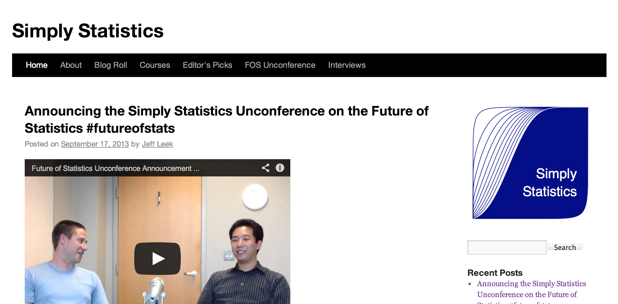
about me

Slide 6
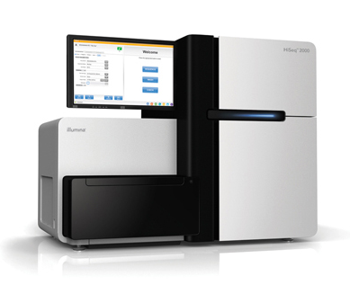
my day job
http://www.illumina.com/systems/hiseq_2000_1000.ilmn

Slide 7
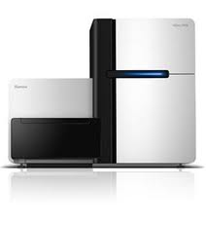

my day job
Develop technology
Apply to individuals
Identify features
Build procedure
Distribute results

Slide 8
high-throughput tech ➔ clinical tool
Develop technology
Apply to individuals
Identify features
Build procedure
Distribute results
Preprocessing
Experimental Design
Statistical inference
Machine learning
Software/Visualization

Slide 9
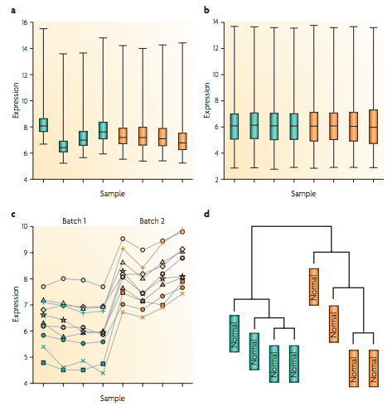
high-throughput tech ➔ clinical tool
Batch Effects
Preprocessing
Experimental Design
Statistical inference
Machine learning
Software/Visualization
Leek et al. Nat. Rev. Genetics 2010

Slide 10
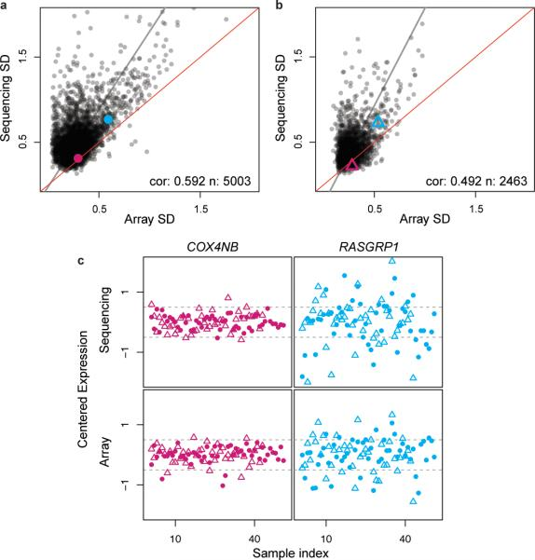
high-throughput tech ➔ clinical tool
RNA-Seq Sample Size
Preprocessing
Experimental Design
Statistical inference
Machine learning
Software/Visualization
Hansen et al. Nat. Biotech. 2011

Slide 11
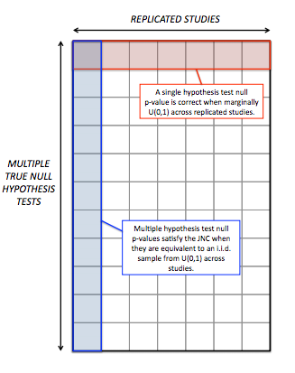
high-throughput tech ➔ clinical tool
Multiple Testing
Preprocessing
Experimental Design
Statistical inference
Machine learning
Software/Visualization
Leek and Storey, SAGMB 2011

Slide 12
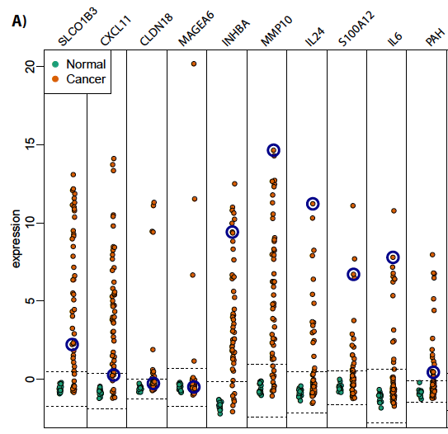
high-throughput tech ➔ clinical tool
New Signatures
Preprocessing
Experimental Design
Statistical inference
Machine learning
Software/Visualization
Corrada Bravo et al. BMC Bioinfo. 2012

Slide 13
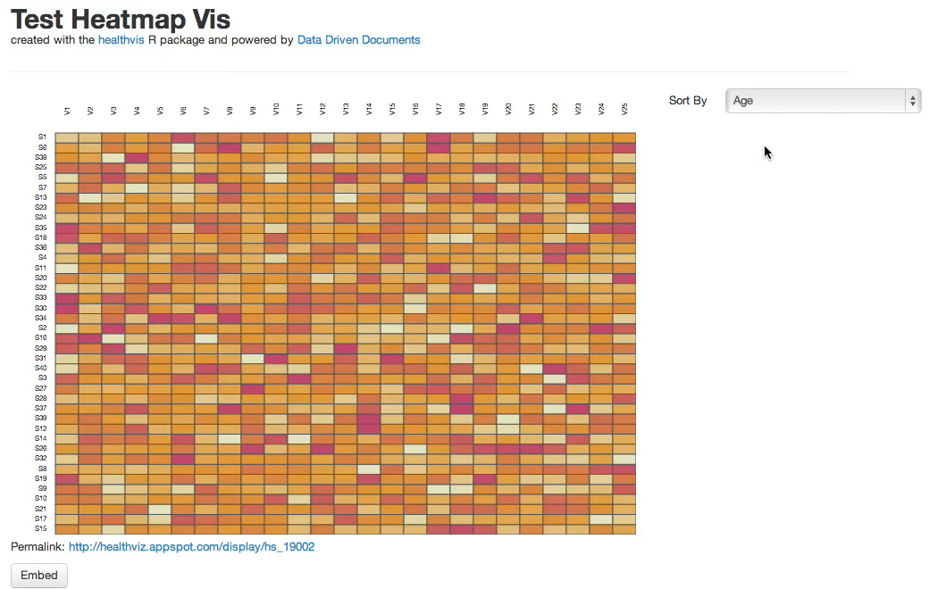
high-throughput tech ➔ clinical tool
Data Vis
Preprocessing
Experimental Design
Statistical inference
Machine learning
Software/Visualization
Patil et al. (in prep)

Slide 14
my definition of big data
any data set a doctor can’t analyze in excel

Slide 15



hopkins health data science

Slide 16
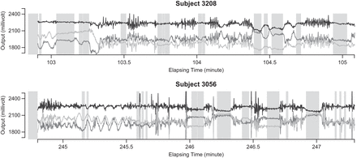
accelerometers

Slide 17
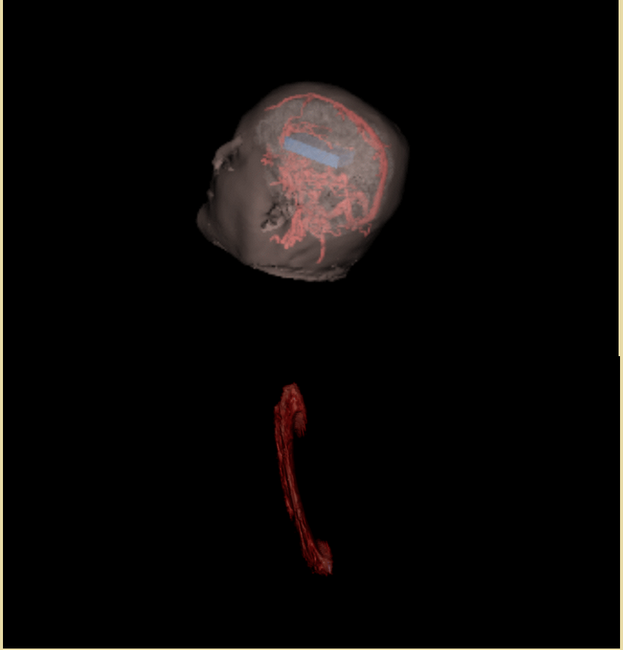
brain scans

Slide 18
and sequencers

Slide 19
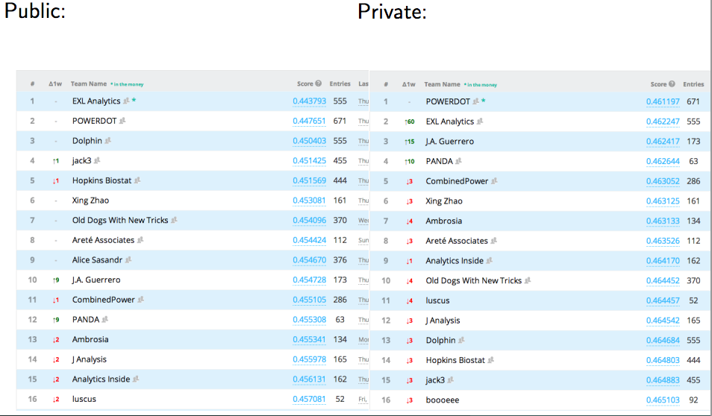

oh my!
Argh! Overfit!

Slide 20
how i got into teaching the masses
Previously: Youtube lectures and “flipping” the classroom.
7-1-2012: Brian tells me Hopkins has a deal with Coursera
7-1-2012: Roger walks by my office and I tell him he’s in
7-2-2012: Roger and I sign up
7-5-2012: Roger and I make our advertising videos
7-17-2012: Official announcement by JHU
9/2012 – Roger’s/Brian’s courses run
1/2012 – Jeff’s course runs

Slide 21
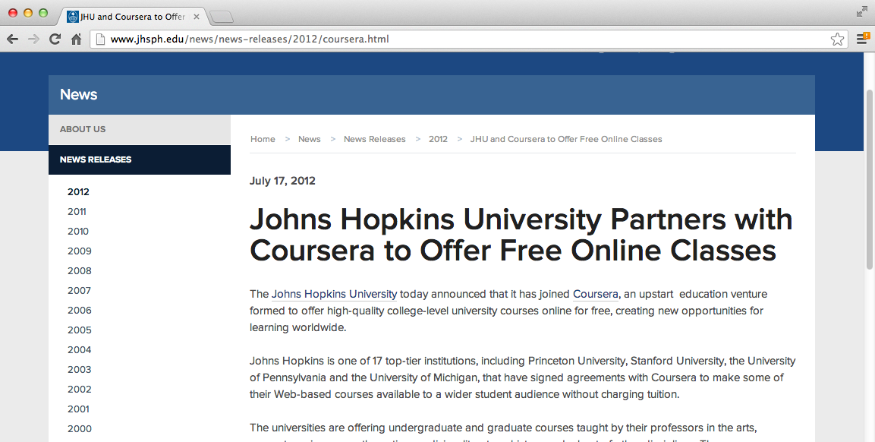
official announcement

Slide 22
the next day
from: Gooding, Ira <igooding@jhsph.edu>
date: 7/18/12
I heard from Coursera this morning and learned that more than 10,000 students have already signed up for our JHSPH courses!

Slide 23
the day after that
from: jtleek@gmail.com
Roger let me know you gave him a ballpark figure for the number of students registered for his course "Computing for Data Analysis”. Could you give me an idea of how many have registered for my course "Data Analysis?”

Slide 24
the day after that
pangwei@coursera.org
from:
Hi Jeff,
7,000 students! It's pretty awesome. (You'll be able to check this out yourself next week, once the class sites are up.)

Slide 25
the day after that
from: rdpeng@gmail.com
You are f**ed.
-roger

Slide 26
by the numbers “computing for data analysis (v1)”
Measurement | Number of Participants
Students registered | 50,651
Students participated | 34,828
Students watching videos | 26,707
Students submitting quizzes | 11,271
Students submitting assignments | 5,814
Students posting to forum | 2,266

Slide 27
by the numbers “computing for data analysis (v2)”
Measurement | Number of Participants
Students registered | 40,863
Students participated | 35,922
Students watching videos | 29,081
Students submitting quizzes | 16,146
Students submitting assignments | 8,550
Students posting to forum | 3,255

Slide 28
by the numbers “mathematical biostatistics bootcamp (v1)”
Measurement | Number of Participants
Students registered | 15,197
Students participated | 10,703
Students watching videos | 7,985
Students submitting quizzes | 2,141
Students submitting assignments | NA
Students posting to forum | 729

Slide 29
by the numbers “mathematical biostatistics bootcamp (v2)”
Measurement | Number of Participants
Students registered | 18,621
Students participated | 11,025
Students watching videos | 7,941
Students submitting quizzes | 5,361
Students submitting assignments | NA
Students posting to forum | 463

Slide 30

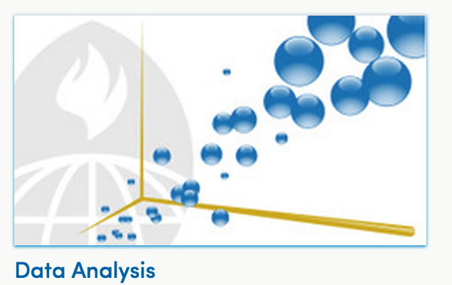
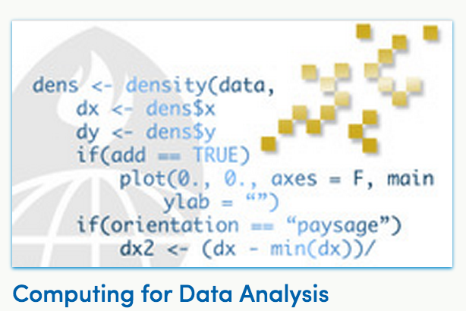
the numbers so far
300k+ Enrolled To Date

Slide 31
why i (we) did this*
We genuinely believe in open-source
We wanted to be part of an experiment
Advertising for Simply Statistics
Advertising for Hopkins
* May not be sorted by actual importance

Slide 32
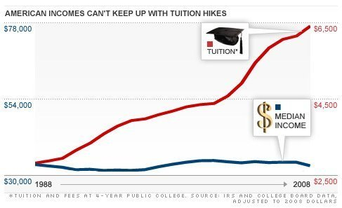
complimentary problems

Slide 33
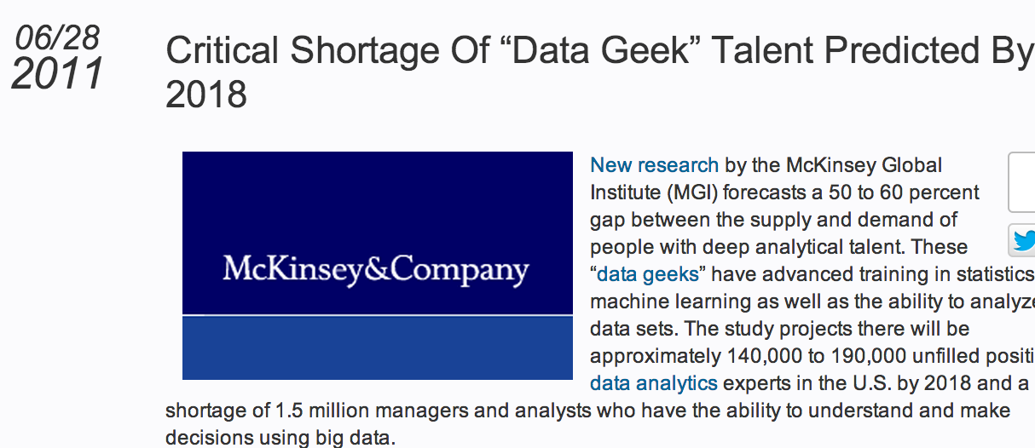
complimentary problems

Slide 34
course structure (CDA – Peng)
4 weeks
4 programming assignments
4 quizzes
3 hours of videos in 8-10 min chunks per week

Slide 35
course structure (MBB – Caffo)
7 weeks
7 quizzes
7 optional homework assignments
2 hours of videos in 10-25 min chunks per week

Slide 36
course structure (DA – Leek)
8 weeks
8 quizzes
2 data analysis assignments
2 hours of videos in 10-15 min chunks per week

Slide 37
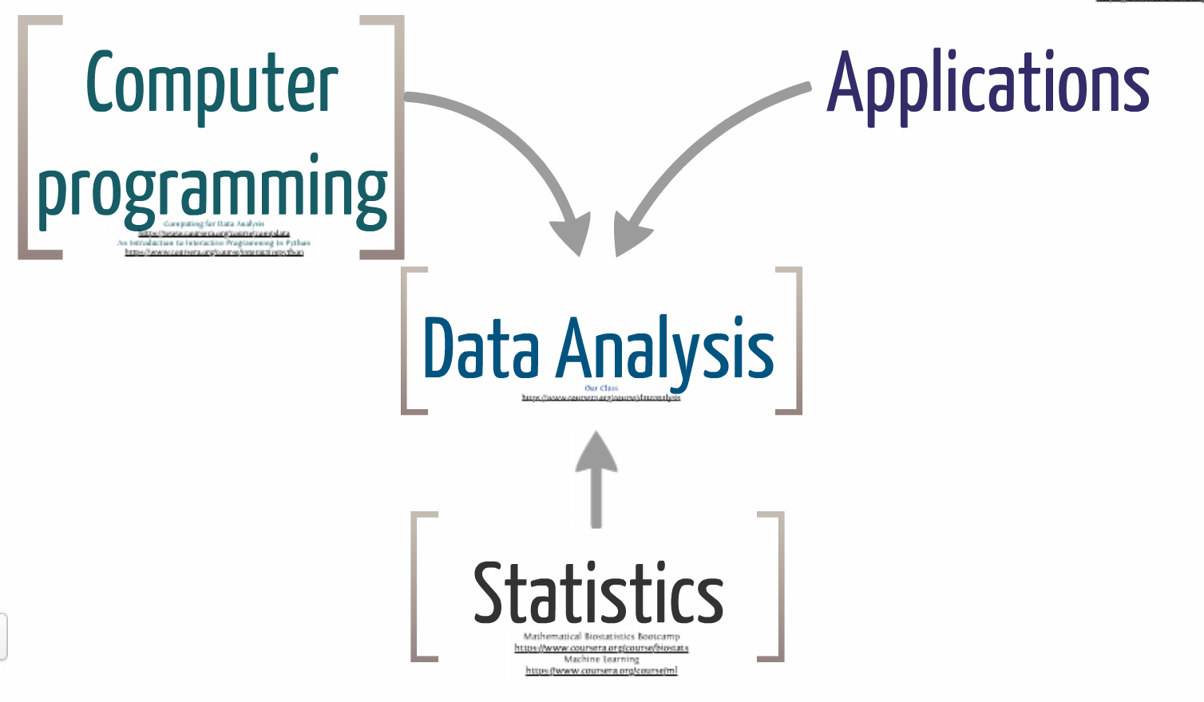
how i think of data analysis
http://simplystatistics.org/2013/01/10/the-landscape-of-data-analysis/

Slide 38
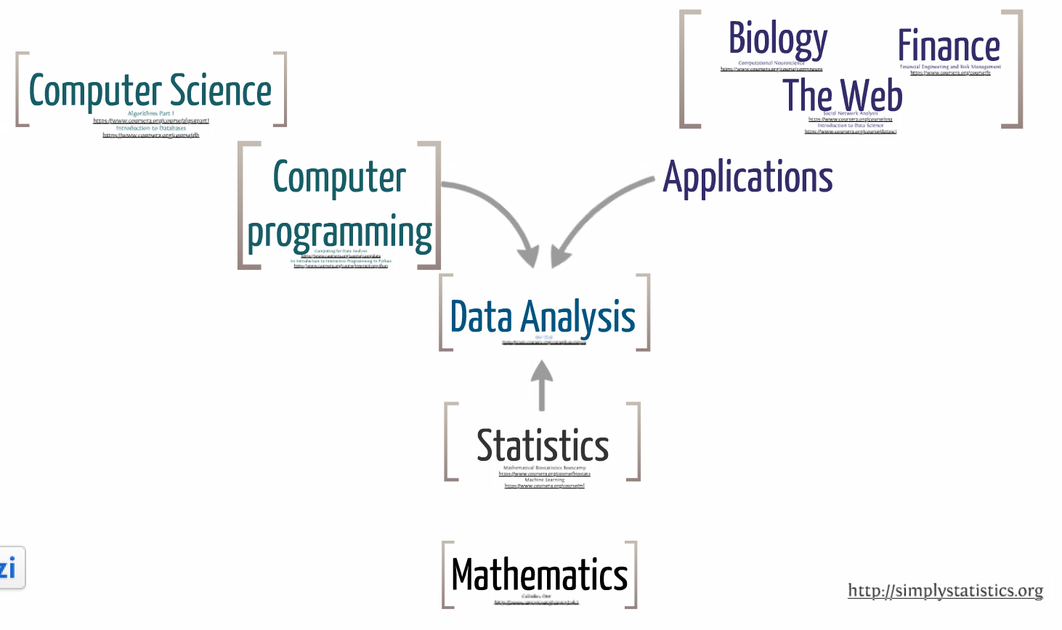
zooming out

Slide 39

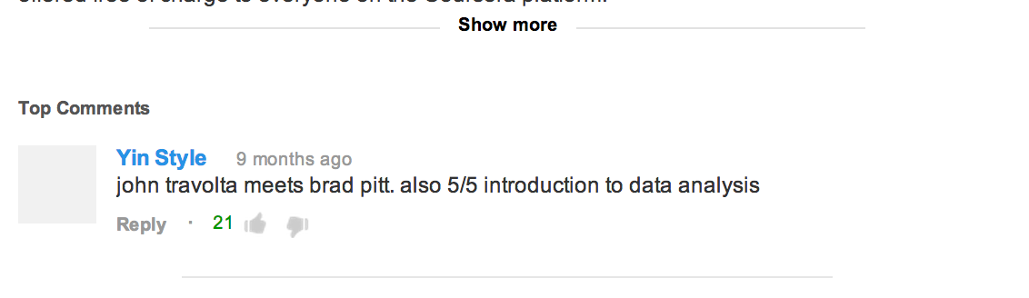
my intro video

Slide 40
course structure (DA – Leek)
8 weeks
8 quizzes
2 data analysis assignments
2 hours of videos in 10-15 min chunks per week

Slide 41
what I covered

Slide 42
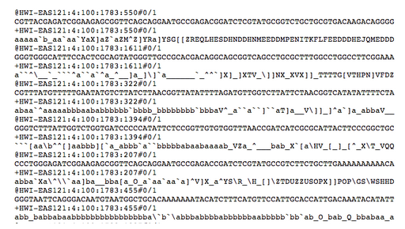
what is data?

Slide 43
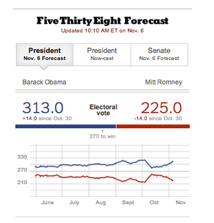
types of analyses

Slide 44
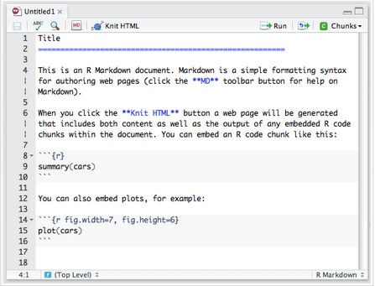
organizing a data analysis

Slide 45
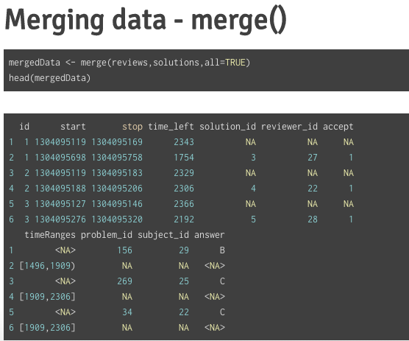
data munging

Slide 46
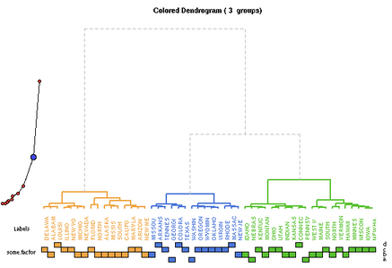
eda

Slide 47
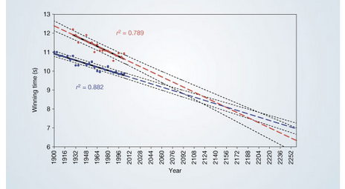
statistics
http://www.nature.com/nature/journal/v431/n7008/fig_tab/431525a_F1.html

Slide 48
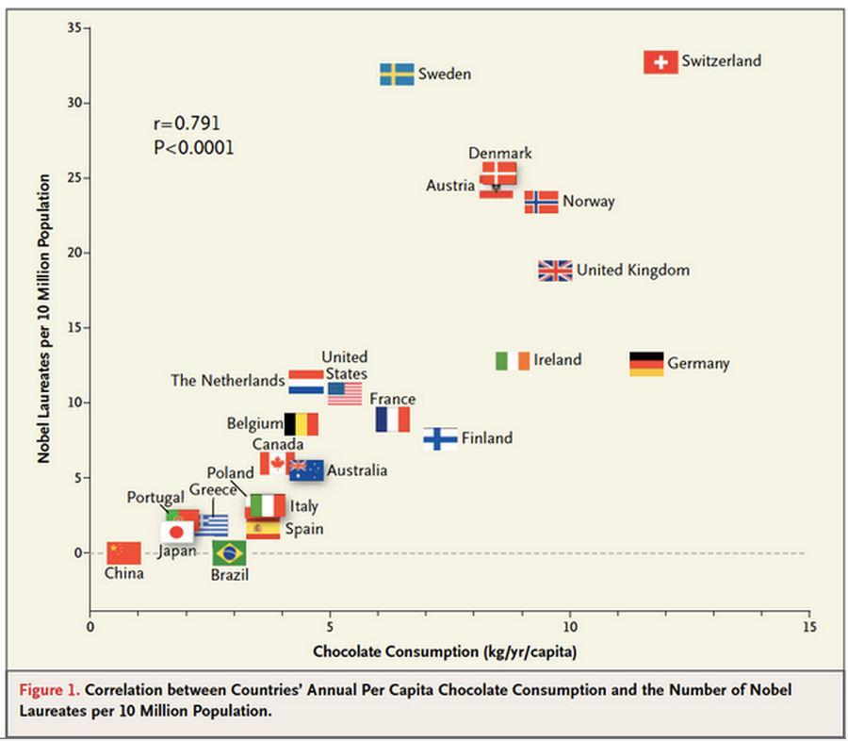
concepts like confounding
http://www.nejm.org/doi/full/10.1056/NEJMon1211064

Slide 49
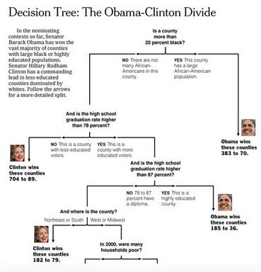
simple machine learning
http://graphics8.nytimes.com/images/2008/04/16/us/0416-nat-subOBAMA.jpg

Slide 50
how do you teach 100k+ people?

Slide 51

coursera

Slide 52
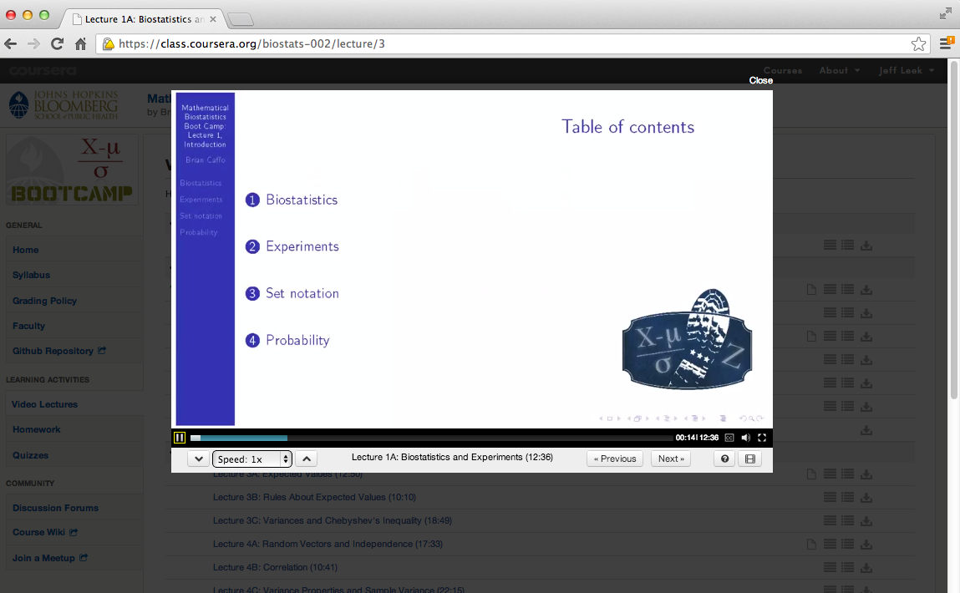
coursera platform (videos)

Slide 53
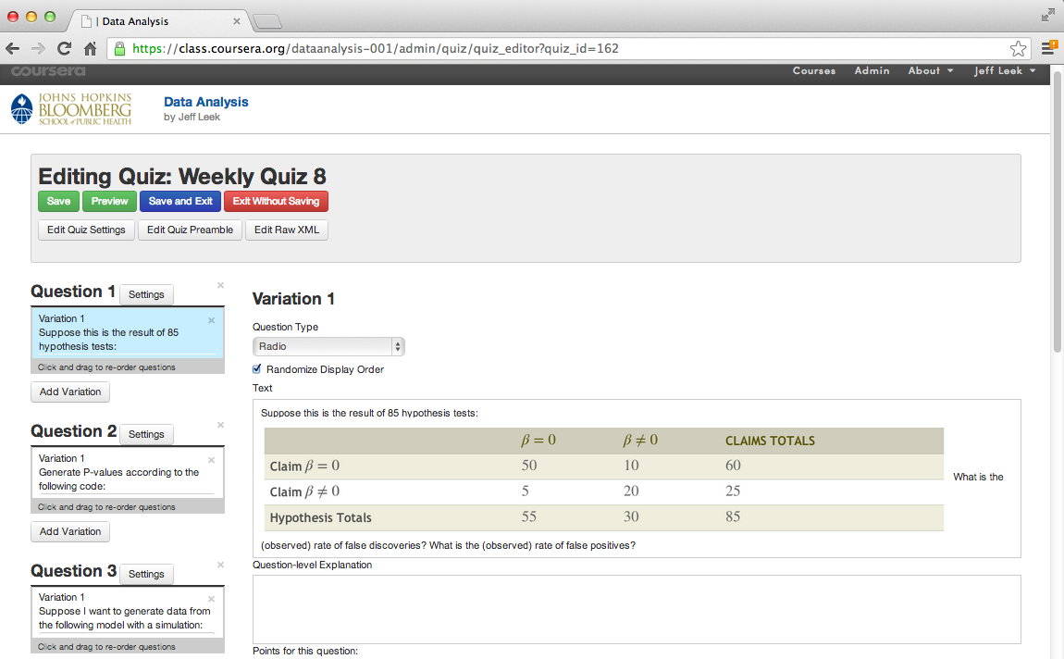
coursera platform (quizzes)

Slide 54
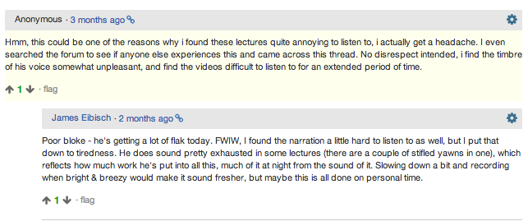
coursera platform (forums)

Slide 55
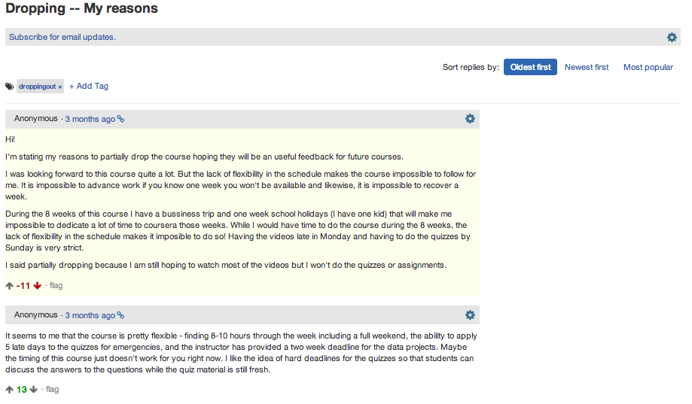
coursera platform (forums)

Slide 56
peer-grading

Slide 57
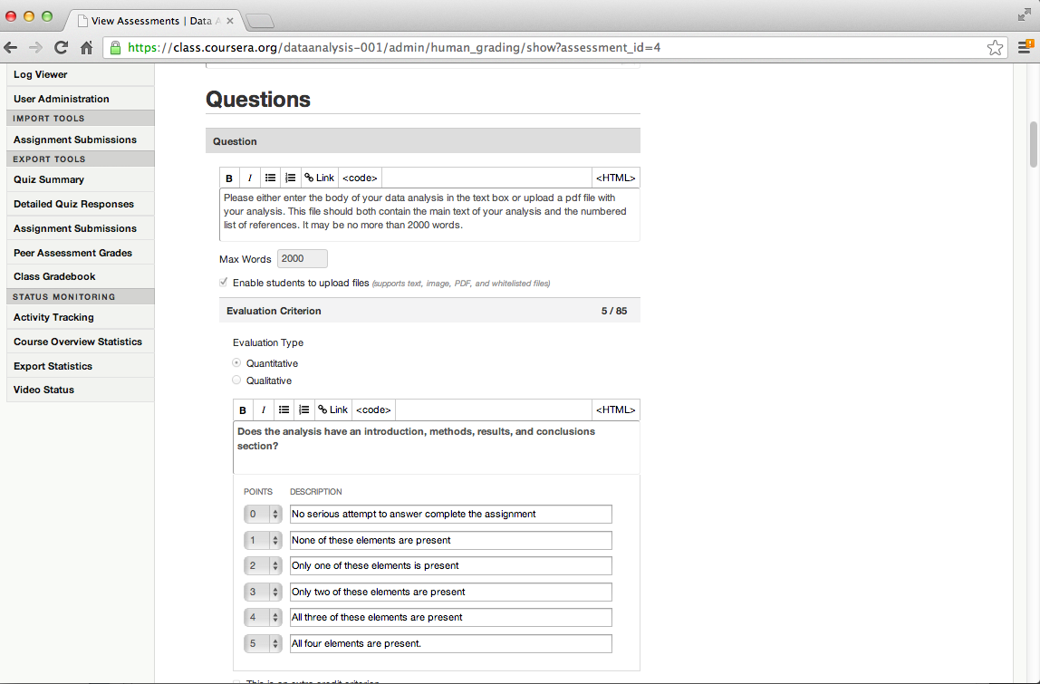
coursera platform (peer review)

Slide 58
data analysis rubric
Formatting
1. Does the analysis have an introduction, analysis, and conclusions? (wt = 10)
2. Does the analysis include references for the statistical methods used? (wt = 2)
3. Are figures labeled and referred to by number in the text? (wt = 2)
4. Are figure captions descriptive enough to stand alone? (wt = 2)
5. Is the analysis written in grammatically correct English? (wt = 5)
The Question
1. Is the type of question specified (exploratory, inferential, predictive, causal)? (wt = 10)
2. Does the analysis answer the scientific question? (wt = 10)
3. Does the analysis report a measure of uncertainty about the answer? (wt = 10)
…
http://bit.ly/1esZiUT

Slide 59
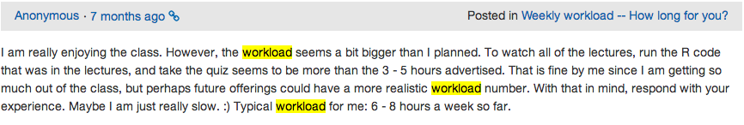
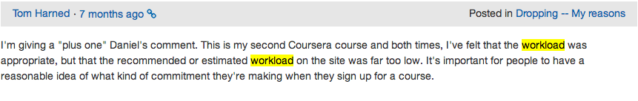
workload (them)

Slide 60
lessons learned
people care about the certificate a lot
1%/98%/1% rule of internet message boards
careful where you post data/send people

Slide 61
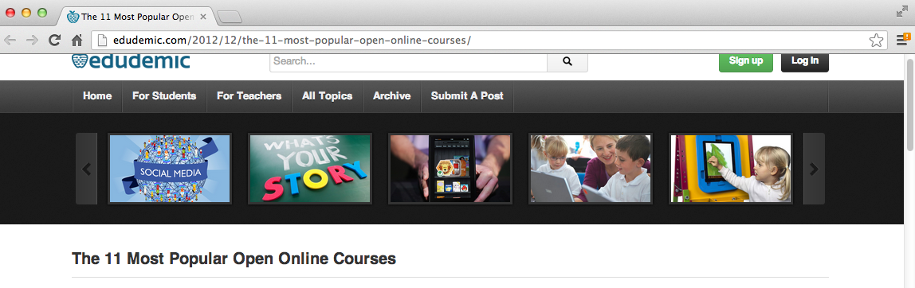
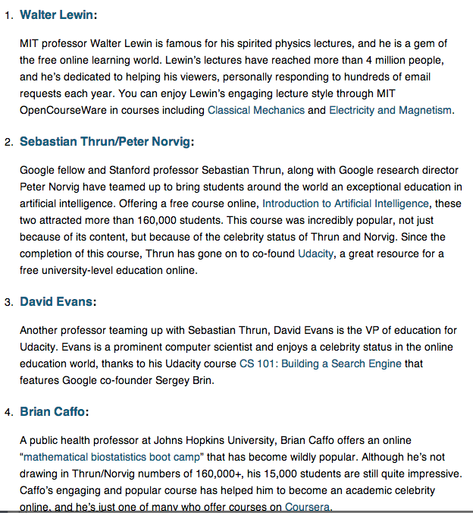
benefits of coursera

Slide 62

benefits of coursera

Slide 63
benefits of coursera
email to brian:
"I was reading the coursera course description you are teaching on Mathematical Biostatistics Boot Camp. I have a question for you. I have a son in prison in Georgia, and I would like him to take this course because he has the background for this class. The problem I have is that he is not allowed to use the internet. Would it be possible for me to down log the necessary information for him? He would be able to read and write the homework assignments, and I will write his answers for you."

Slide 64
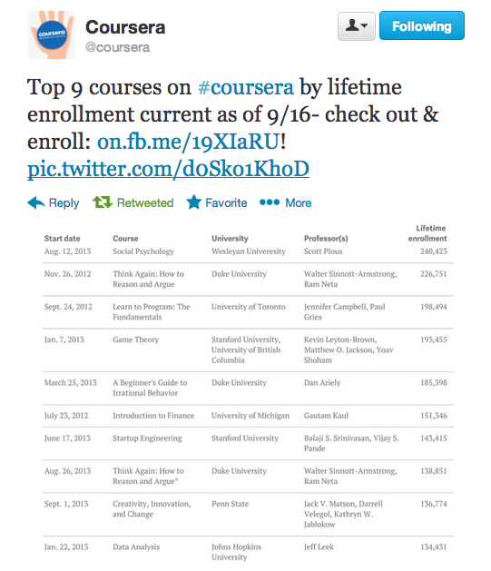
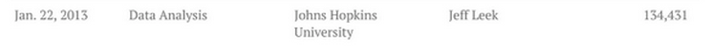

Slide 65
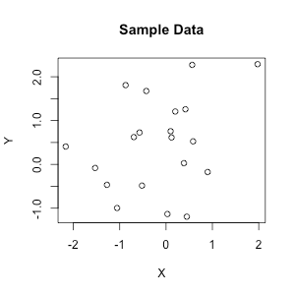
a side benefit of the platform

Slide 66
large-scale clinical trial of eda

Slide 67
workload (me)
First time, depends on course
Easily adaptable -> moderate effort
New/harder to adapt -> large effort
If you are an idiot like me -> huge effort
Repeat offerings
Much lower effort
Roger got an email telling him his class was finished.

Slide 68

would i do it again?
ask them:

Slide 69
is this going to change things?

Slide 70
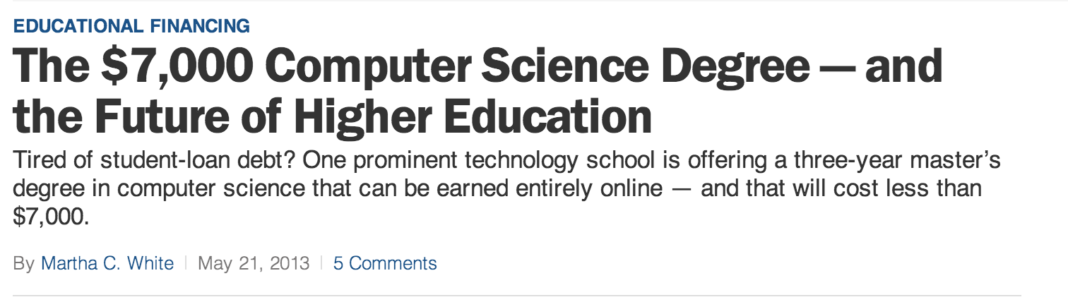
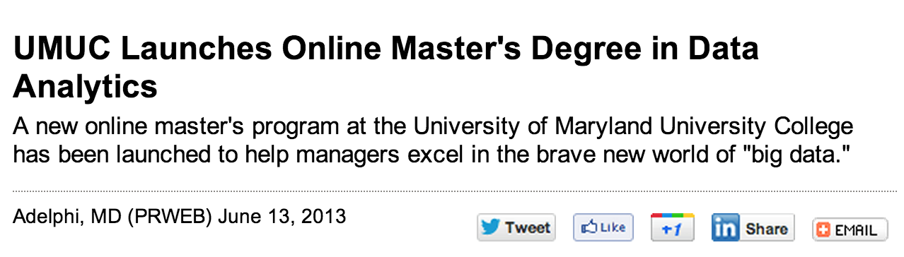
yes!

Slide 71

no!

Slide 72


no!

Slide 73
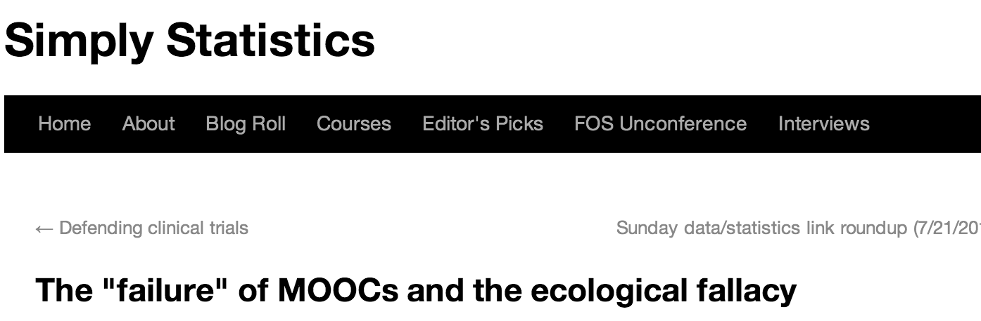
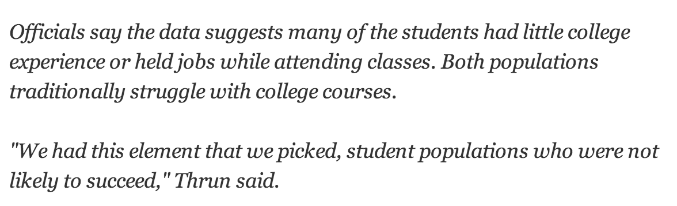
easy there!

Slide 74

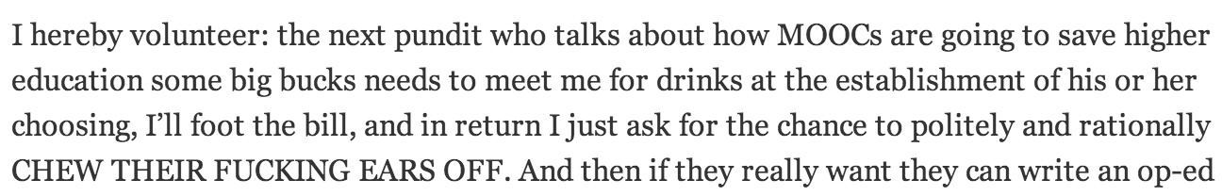
whoa!

Slide 75
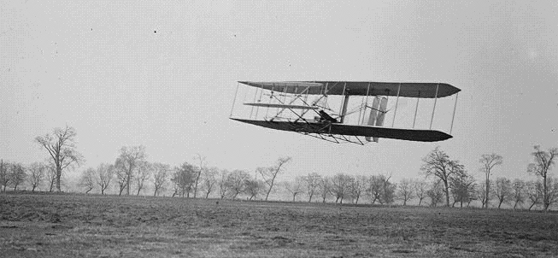
the reality
http://en.wikipedia.org/wiki/File:1904WrightFlyer.jpg

Slide 76
local issues
shorter videos (5-10 min)
break it into more classes
add comments to peer review (if possible)

Slide 77
for the bar…
Hopkins Data Science Lab and You!
Will this have an impact on you?
How will this be self-supporting?
Should we make this interactive?

Slide 78

swirl!
http://ncarchedi.github.io/swirl/

Slide 79

http://simplystatistics.org/unconference/

